Slide 1





Urban Biodiversity Life Rafts:
A Way to Conserve our Pollinators
Maxine Cruz, Dr. Katy Prudic, Dr. Kathy Gerst
University of Arizona | School of Natural Resources and the Environment | USA-NPN
Arizona NASA Space Grant Symposium, April 2021

Slide 2
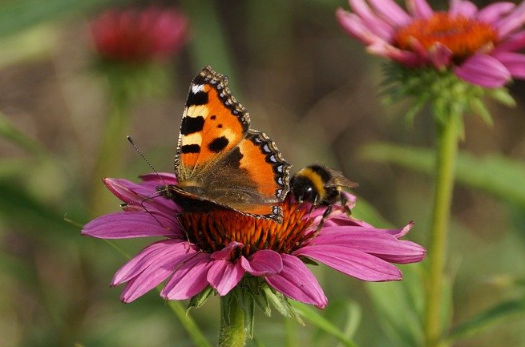
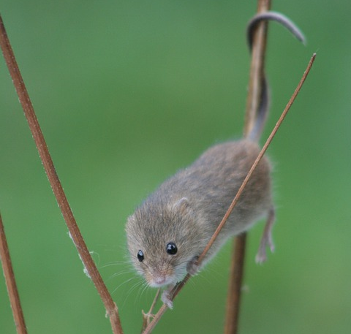
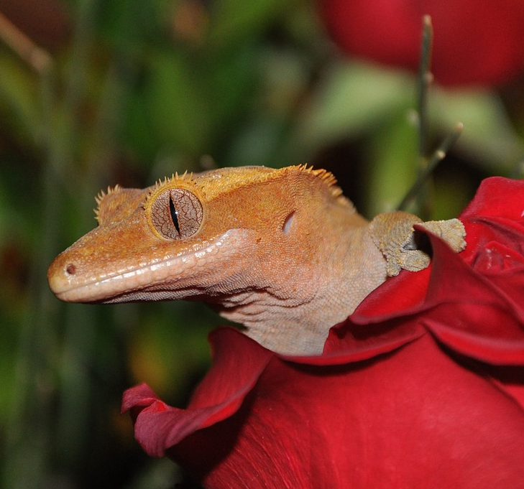
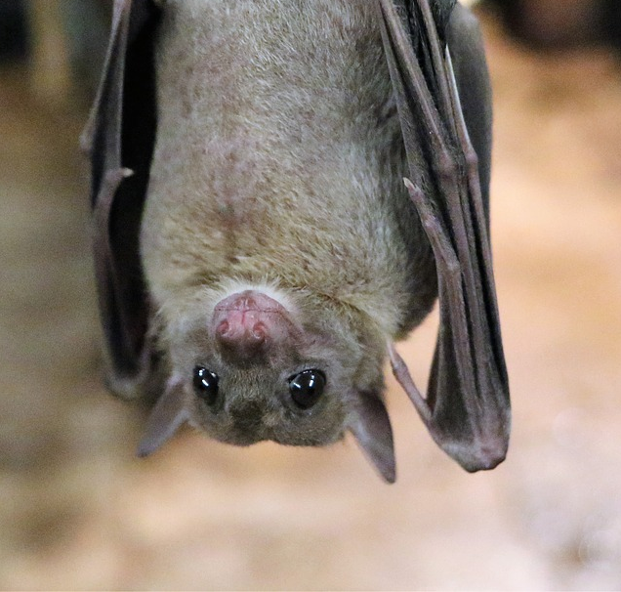
What is a pollinator?
- They transfer pollen (male parts of plant) to the female part of the plant → seeds → baby plants!
- About 87.5% of flowering plants (~308,000 species) and 75% of world crops need pollinators to reproduce
- Our focus: bee (Hymenoptera) and butterfly (Lepidoptera) pollinators
- Now, what is going on with them?
Some pollinators hanging out
Photos from Pixabay
Notes:
pollinator presentation 1 https://docs.google.com/presentation/d/1_QDaGepeFDKF0osV3GcMQBEBwauLdy5vAcyogzGEhYw/edit?usp=sharing
pollinator talk two https://docs.google.com/presentation/d/1UF4BBuPJqAs9zjdGj6cV8FevwRL_VmYdww7Q0H-XM-g/edit?usp=sharing
pollinators are generally any organism that is able to transfer male gametes of a plant (pollen) to another plant's females parts (pistil)
plants can fertilize on their own or have the wind or water take their pollen
1) transfer by wind and water only supports some parameters of pollen
2) eventually fertilizing on your own for awhile can lead to issues because there is no genetic variation

Slide 3
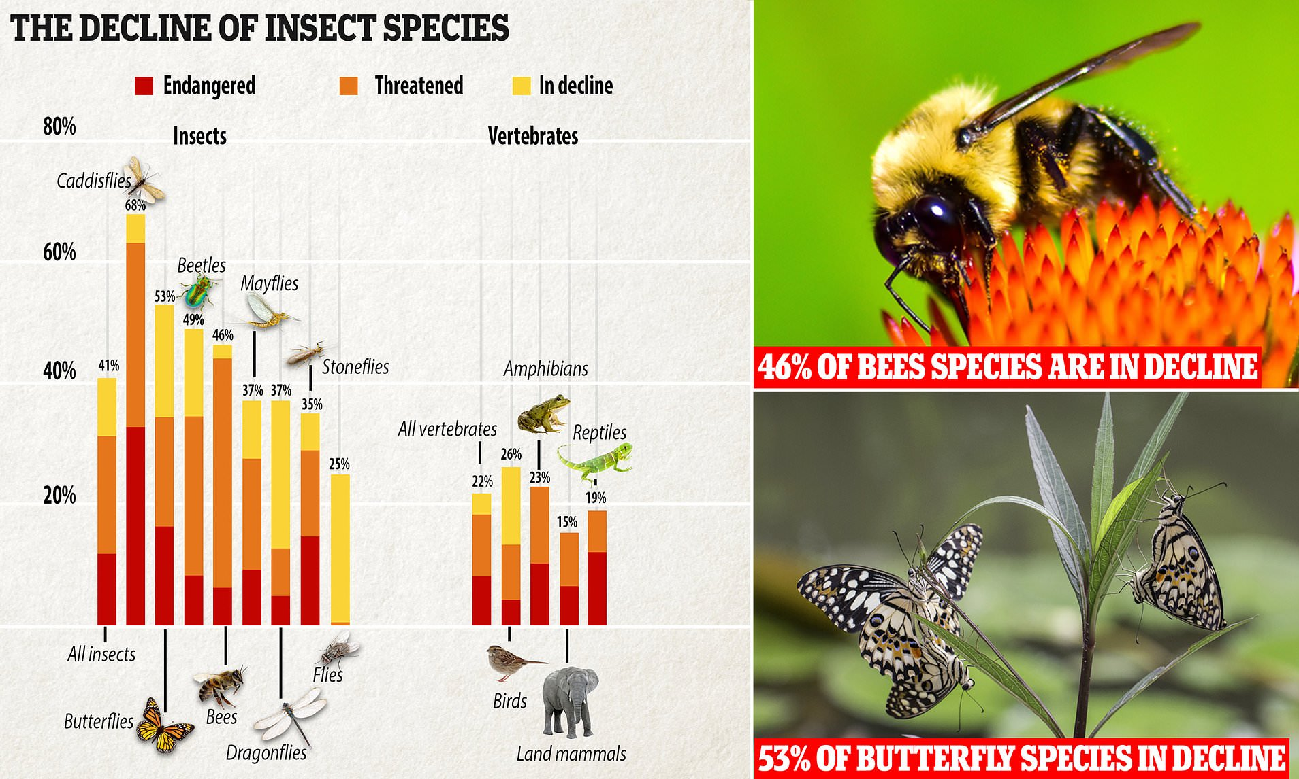
Pollinator biodiversity is declining globally
↑ Land Use Change: urban/suburban expansion and agriculture
↑ Pesticide Application: water, soil, and air contamination and non-target effects
↑ Climate Change: air pollution, extreme weather, drought, wildfire
Photo from Dr. Prudic
Notes:
This graph shows us that compared to vertebrates, insects biodiversity is declining at about 20% more than vertebrates are
With caddisfly species declining the most at 68%
Followed by butterflies which are declining at 53%, beetles, and then our bees at 46%

Slide 4
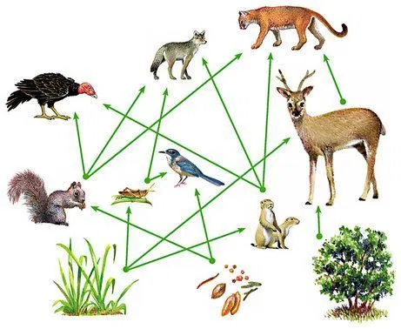
So, why does this matter to us?
- Plants provide food, clean air, clean water, erosion protection, carbon storage, and homes to other creatures
- Cascading effects in an ecosystem:
↓ Pollinator biodiversity
↓ Plants
↓ Vertebrates and Predatory Invertebrates
- And other environmental imbalances
Photo from: https://bsahely.com/2018/06/30/understanding-how-trophic-cascades-shape-our-world/
Notes:
What happens as a result from the previous slide
Everything in an ecosystem is related to each other

Slide 5
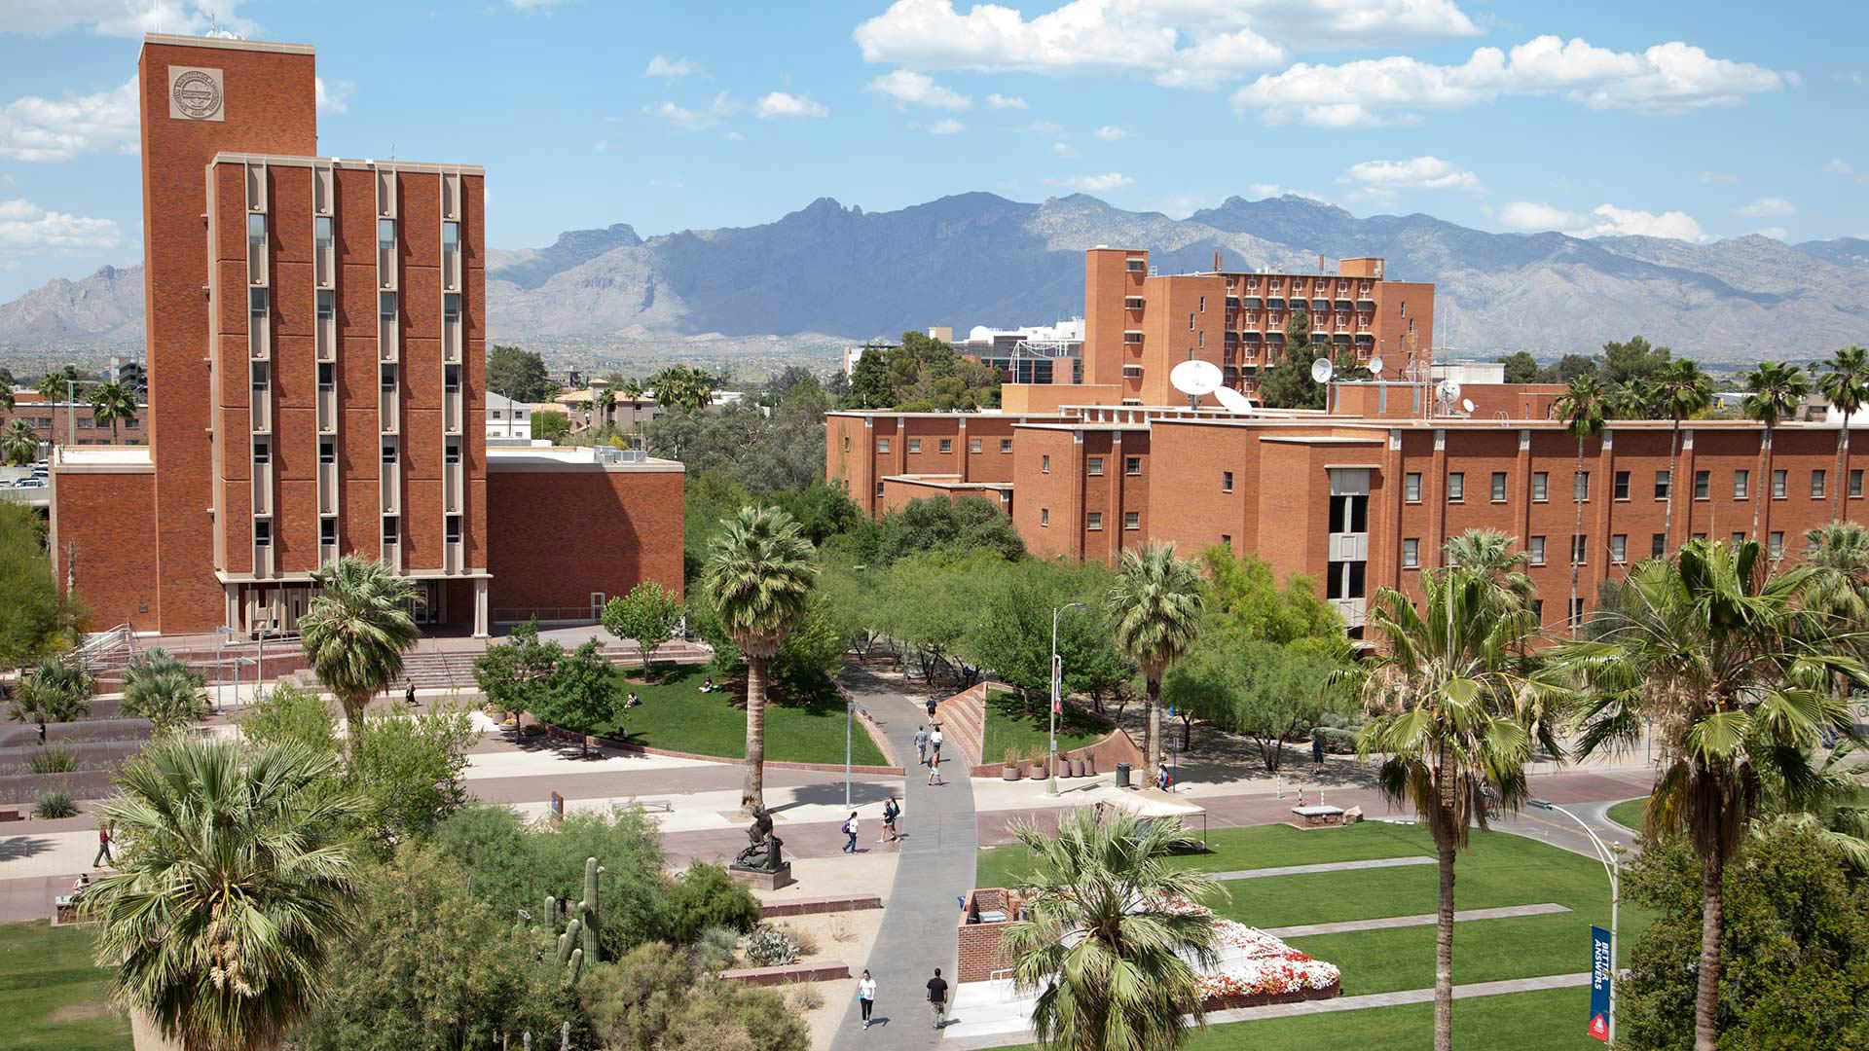
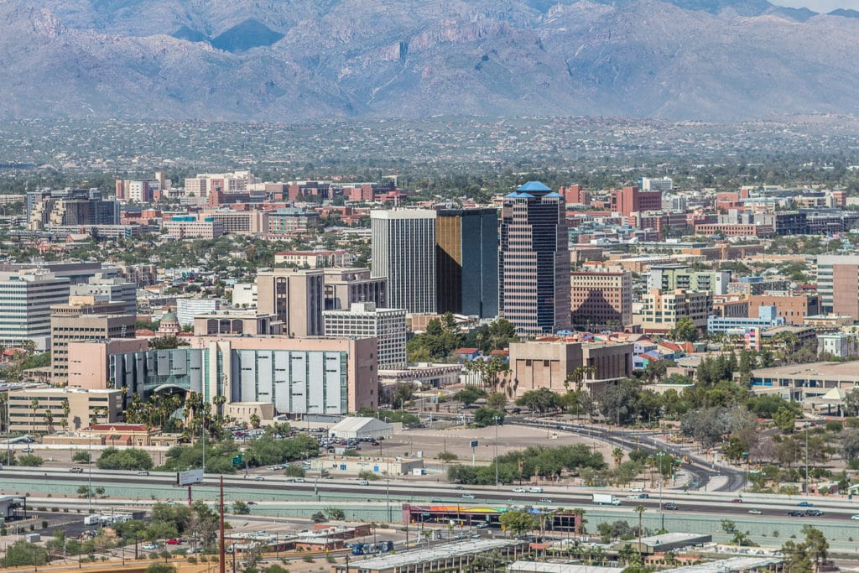
Universities as pollinator biodiversity hotspots
- College campuses are often landscaped
- Result is an area that is different from the surrounding urban region
- The UArizona can be a safe spot for Tucson pollinators, but first… we need data
Photos from AZPM and Real Tucson
Notes:
If we can't stop population growth, what can we do?
We can look into improving our urban areas to make them more pollinator and biodiversity-friendly
Universities all over have been researching ways to make their campus better habitats - they are good at conserving species that are endangered / vulnerable
Universities usually have people landscape the area to make it have the appealing, college aura
The landscape usually ends up being different from the city around it

Slide 6
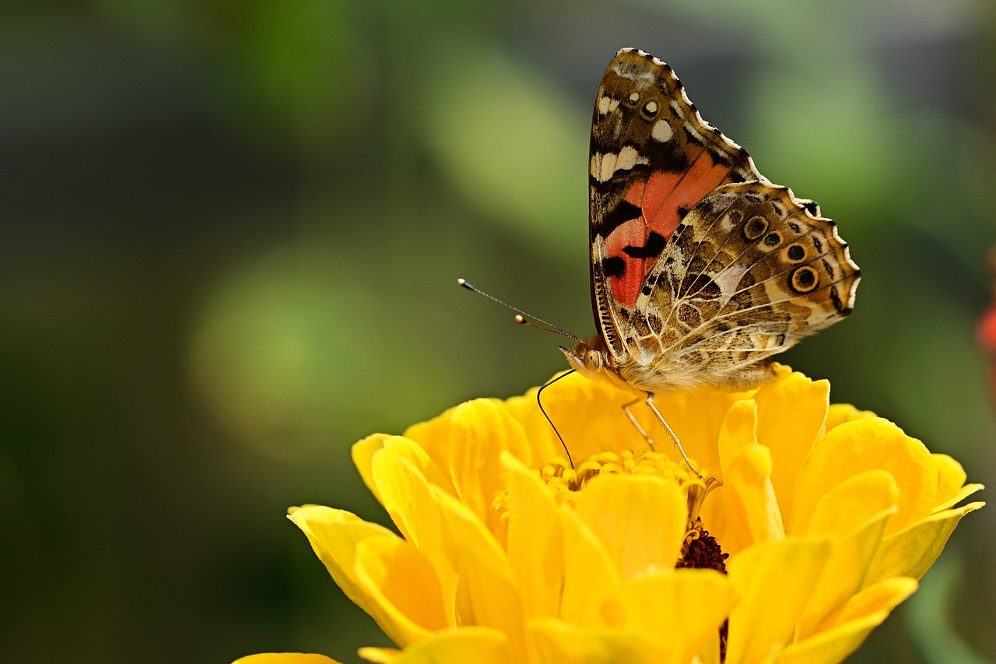
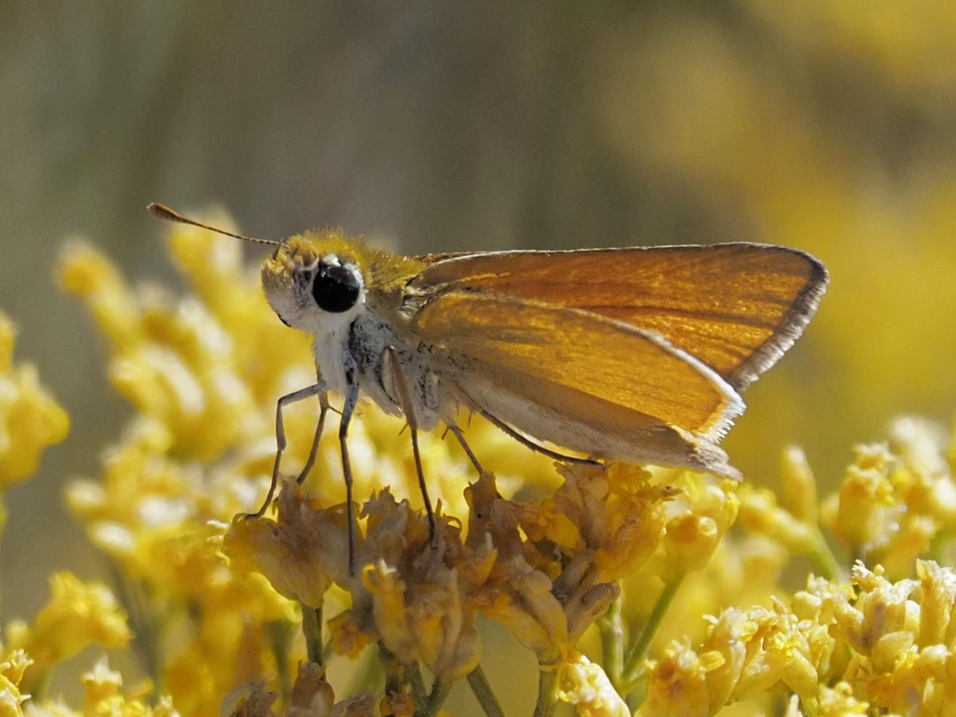
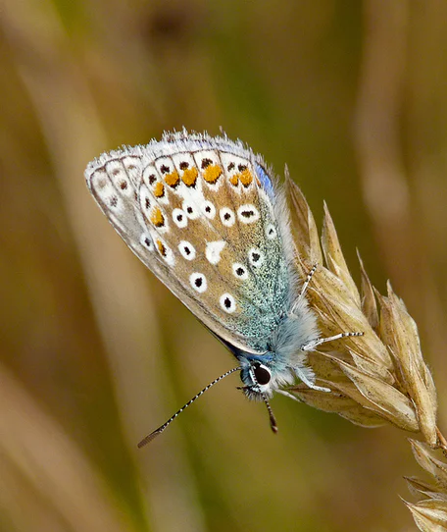
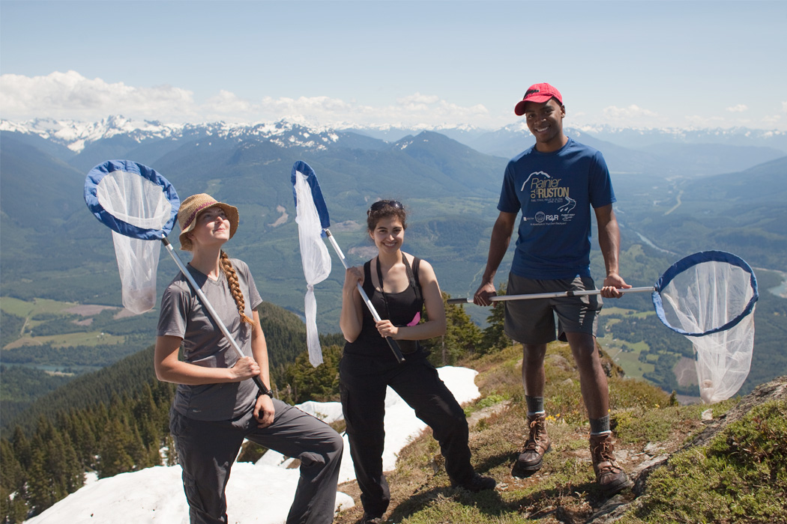
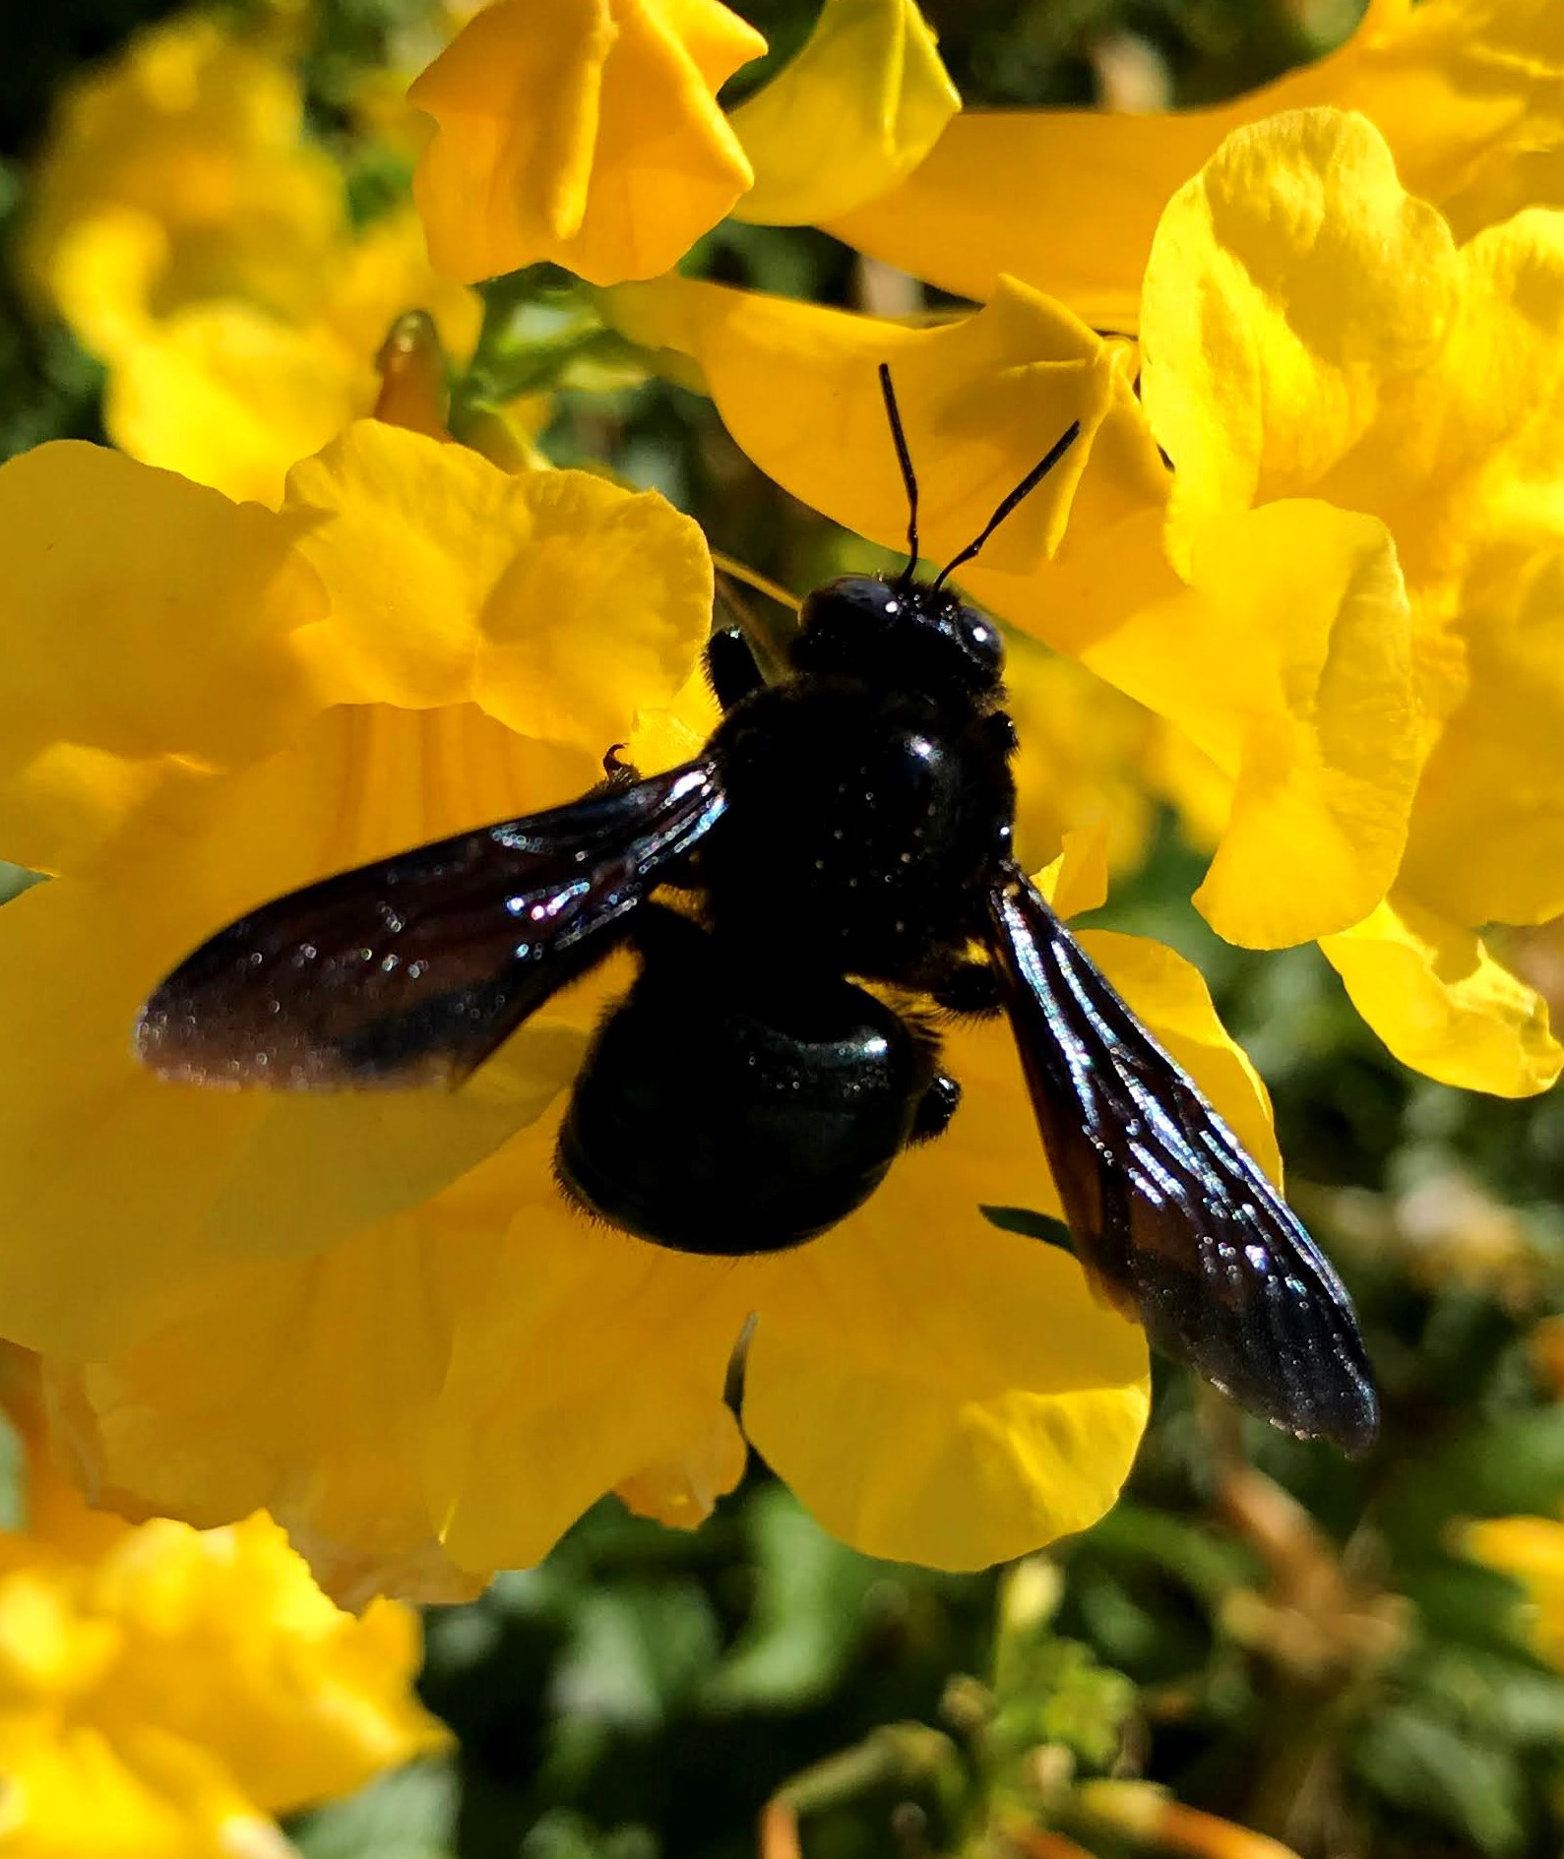
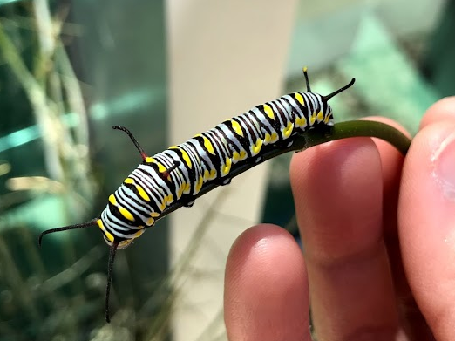
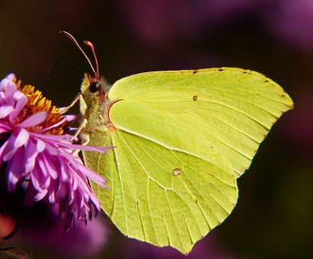
Community (A.K.A. Citizen) Science is a valuable tool
iNaturalist and Nature’s Notebook are active on campus
When were they observed?
Where were they on UArizona campus?
→ We can now run statistics!
Notes:
The data we used for this project was accessible through the iNaturalist and USA-NPN websites
This data is usually verified by scientists and other veteran community members to make it research-grade
The data usually includes the observation data, time, location, and taxonomic classifications
What we can now do with this data is run calculations and statistics to see what is going on / if there are any patterns

Slide 7
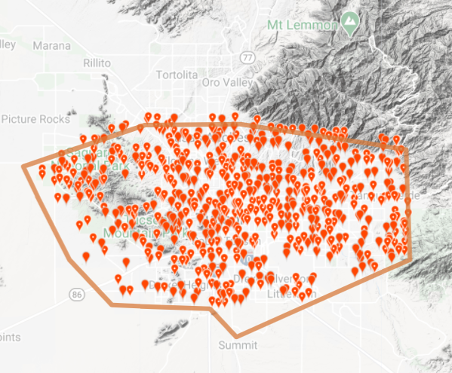

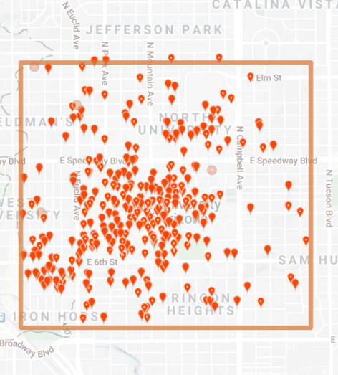
UArizona houses 31% of all Tucson pollinator species
- Almost 31% of all Tucson pollinator species can be found hanging out at the university
- This is from 2015-2019 (5 years)
Images from: iNaturalist and Real Tucson
31%
Notes:
What we found was that from 2015 to 2019, UofA held 18.2% of all Tucson's pollinators
Pollinators: select Hym. and Lep. families
This is a good amount of pollinators that UofA has influence over

Slide 8
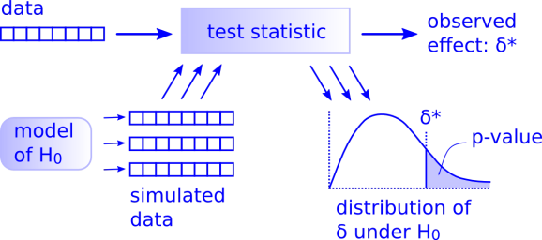
Does this mean UArizona is a pollinator hotspot?
Or is 31% surprising?
If UArizona is a hotspot, then it should have more species than a random sample of all Tucson observations
=> Permutation test is underway comparing UArizona species richness to Tucson species richness
Permutation test schematic
https://www.r-bloggers.com/2019/08/permutation-test-for-nhst-of-2-samples-in-r/
Or https://www.jwilber.me/permutationtest/

Slide 9
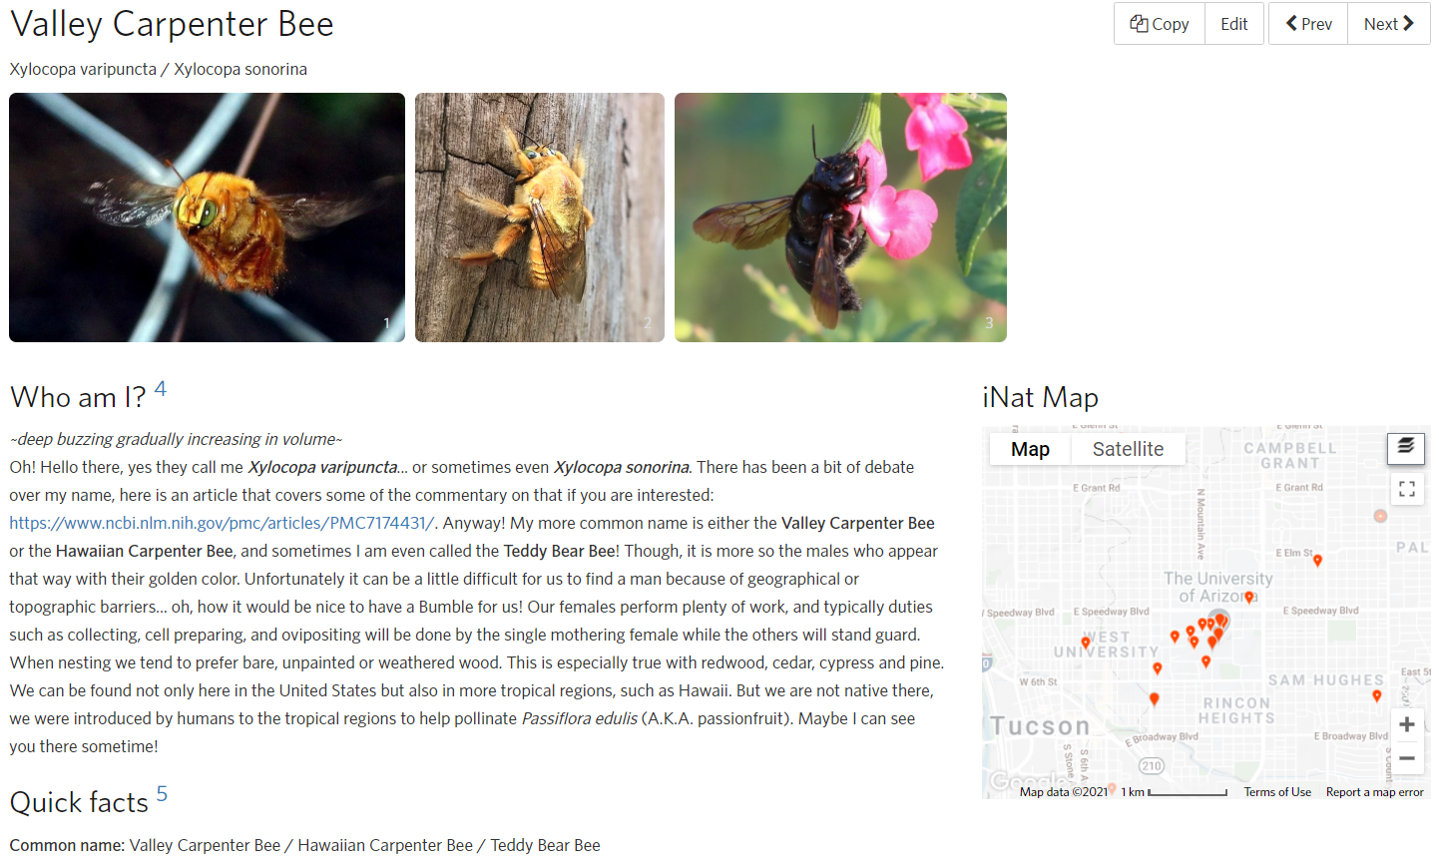
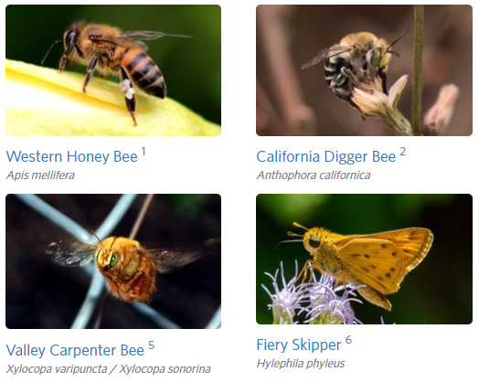
What else can we do with this information? Make a digital field guide!
- Raising awareness of our pollinators → potentially more community data and UA visits
- Information can help improve pollinator habitats on campus (landscaping)
Notes:
What we can also gain from community data is that we know what exactly what species of pollinators reside on campus
Making a digital field of these species and what they like / don't like / who are they anyways
Can be useful because
1) haring with the public of what else lives on the AZ campus as a way to increase informal STEM education and
2) Help grounds and maintenance improve pollinator habitat with pollinator thoughtful design
Being more aware can help us increase their numbers > pollinator babies > more pollinators > happy plants and a happy ecosystem

Slide 10
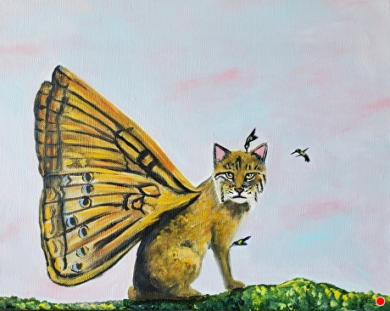


Thank you!
Acknowledgements:
- Dr. Kathleen Prudic
- Dr. Kathy Gerst
- NASA Space Grant program
- All those pollinator community scientists!

